Slide 1
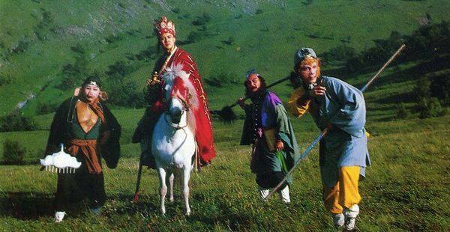
How to Get There? 怎么去？
Lesson 4: Elaboration

Slide 2
Extended Reading 1: Poster 海报

Slide 3
Beijing北京 上海Shanghai 1318km/819ml (similar to: SEA –SF)
Notes:
http://news.qq.com/zt2011/jinghugaotie/feijigaotie.htm

